Slide 1
Data visualization and dashboards with tableau
Project – Jacob Elumeze

Slide 2
Objective
Project Flow Structure
1. Connecting to APIs & Import Data
3. Review Objectives
4. Data manipulations and calculated fields
6. Create meaningful viz. & data insights
5. Building a Model & QA
2. Exploratory Analysis & Assumptions
The objective of this project was to create dashboards using various visualizations and insights from data on Real Estate Prices and Incomes across various districts within Canada
With the insights generated, stakeholders and end users can better understand the changes in real estate prices over the years across various districts in Canada and also see how that compares with changes in earnings over the years as a driver for home purchasing patterns across places of interest in Canada.

Slide 3
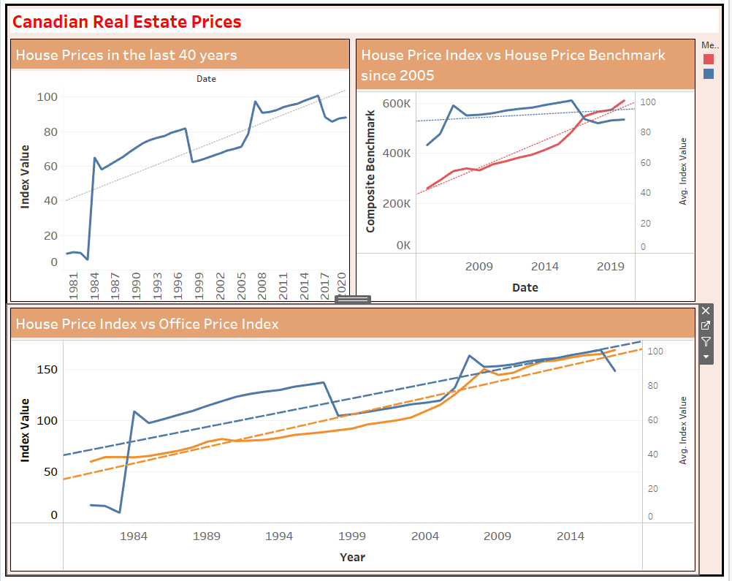
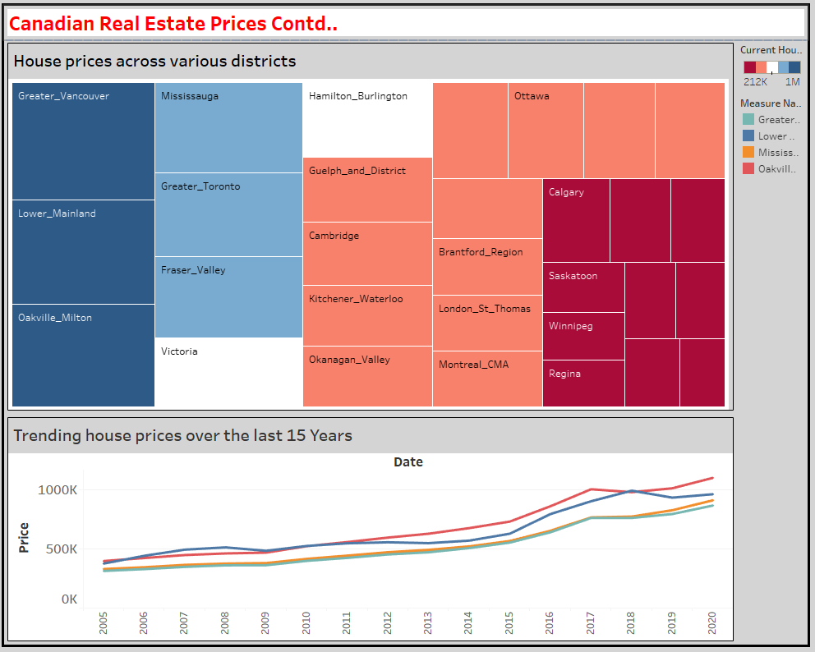
Results and findings

Slide 4
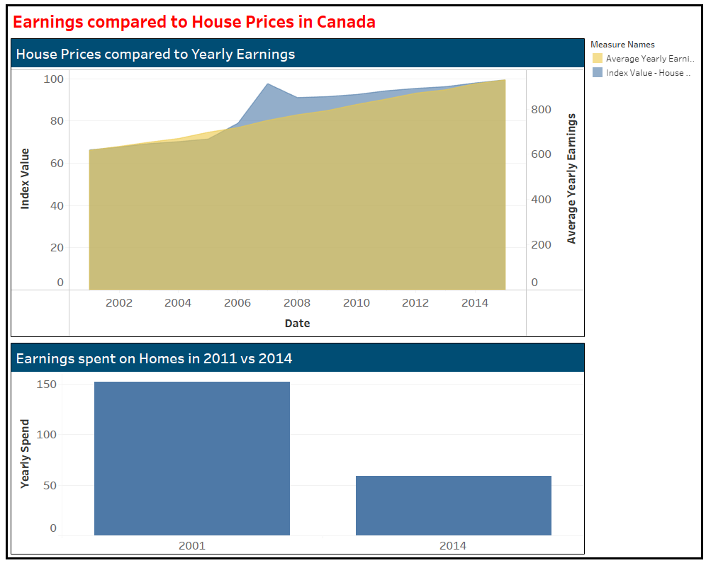
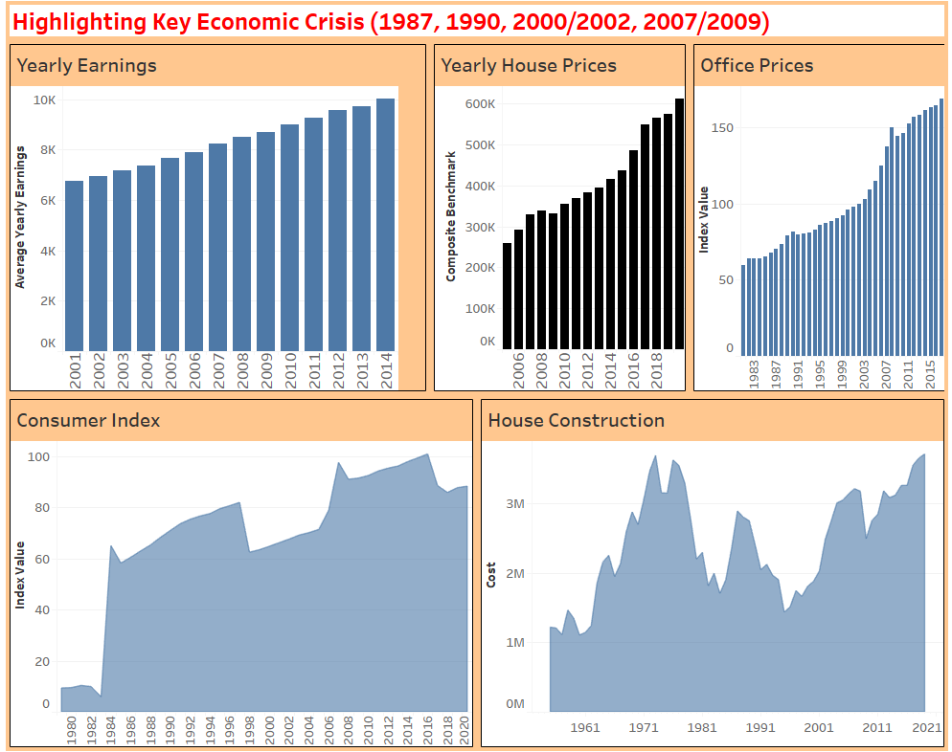
Results and findings

Slide 5
Challenges, learning points & QA PROCESS
Had some challenge with importing the JSON file into tableau, as such, the resulting table was not accurate. I resolved this by importing the file into python and using pandas to convert it into a data frame, then exported it to CSV.
Struggled with data modelling and manipulating data in Tableau, but I believe this will improve as I practice more with the application.
Lastly, I am not sure if it is due to the version of the application I have but I had some limitations with selecting certain visualizations that I needed
Need to improve more in being able to easily understand the underlying objective to easily identify data relationships.

Slide 6
Thank You

